Slide 1
JAYPEE UNIVERSITY OF ENGINEERING AND TECHNOLOGY, GUNA B.Tech Major project presentation Project no. 1 Project title:- Attendance Marker
Project Members: Project Guide :
animesh gupta (191b044) MR. Navaljeet SINGH ARORA
Anirudh Damle (191b045)
Ashish Paliwal (191b074)

Slide 2
Introduction
Attendance Marker
Major project based on the need of AI affiliated attendance software, which fulfils all attendance needs of a class, campus, society, community.
The AI enables a secure channel, where proxy can be reduced.
Simplifying existing attendance systems, procedures.

Slide 3
About the current part of project
The project is a system that takes down students’ attendance using barcode.
Every student is provided with a card containing a unique barcode. Each barcode represents a unique id of students.
Students just have to scan their cards using barcode scanner and the system notes down their attendance as per dates.
System then stores all the students’ attendance records and generates defaulter list. It also generates an overall report in excel sheet for admin.

Slide 4
Motivation
Makes computer vision a possibility, hence enhancing power of Artificial Intelligence.
A new way to Track & Manage Attendance of a class, campus, society, community Hassle-free.
Technology in the current field present is not sufficient.
In this hyper-competitive era, it is essential that this transformation not only meets all the needs but also exceeds the expectations.

Slide 5
Problem Statement
While taking attendance, there is always an issue of time and resources.
While the classes techniques, classes, society, campus are getting smarter, need of a virtual attender (attendance marker) arises.
Less open source software available.

Slide 6
Goals
To create a fully functional attendance system to manage attendance of a class, campus, society, community Hassle-free.
To automate the traditional attendance system by using authentication technique.

Slide 7
Flaws of other software
There are many software present in the market but they are not smart.
User have no freedom to change, as per there requirement.
Hard to understand.
Not user friendly, slow.
All operation are performed manually done.
No, integrity with AI.

Slide 8
Feasibility Analysis
Product safety : Product safety is an important factor in determining the technical and market feasibility of the idea.
Market gap : Filling a viable gap in the market is key to the success of your new product or service.
Viability : Each of the technologies used are freely available in market & technical skills required to handle them are manageable.
User safety : All the user data will be stored in SQLite, and site can be run over reliable server, keeping the environment safe.

Slide 9
Features
Accessible to all eligible users.
Catchy Interface.
User friendly.
Optimized.
Fast.
Diverse use.
Can be used by class, campus, society, community.

Slide 10
Requirement analysis
Hardware Requirement:
Webcam
Software Requirements:
Windows OS
Tools And Techniques used:
Python
Atom
Open CV
MySQL

Slide 11
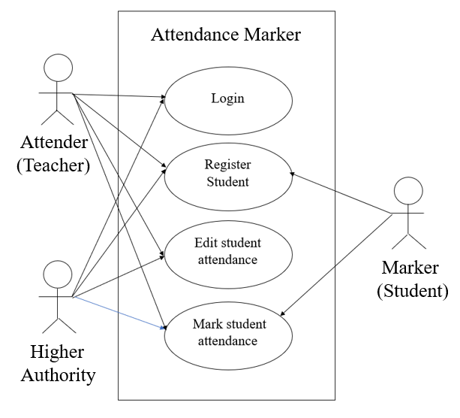
Use case diagram

Slide 12
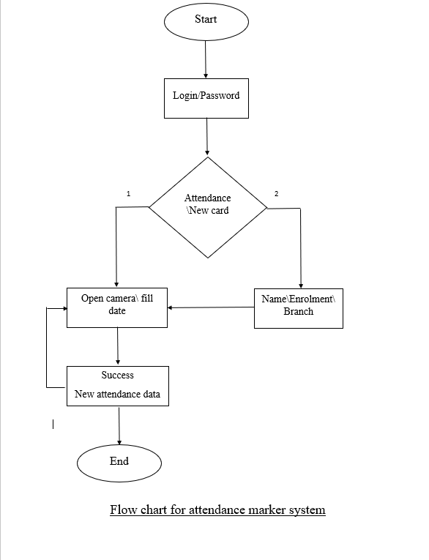
Flow Chart

Slide 13
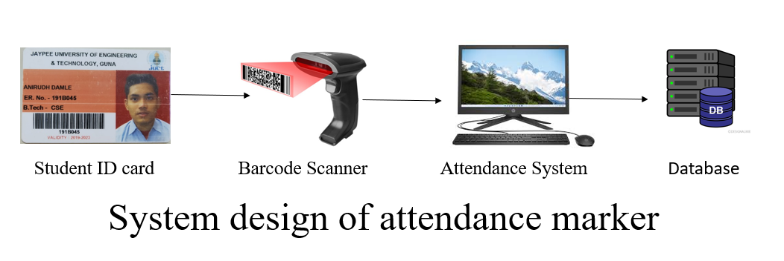
System Design

Slide 14

Project Timeline
Planning
Frontend
Backend\Testing
Deployment

Slide 15
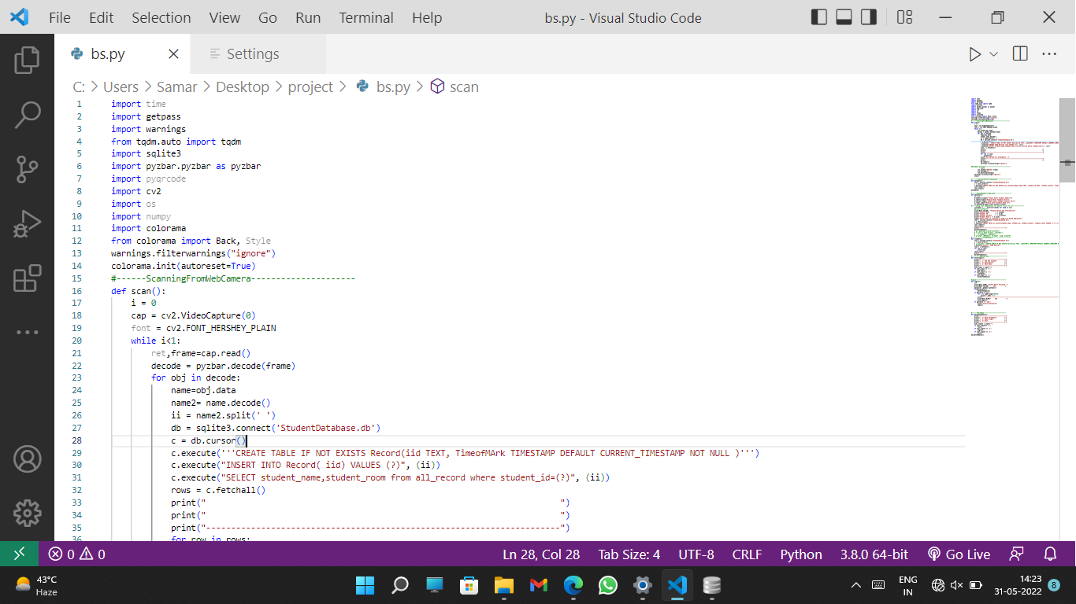
Screenshot of code

Slide 16
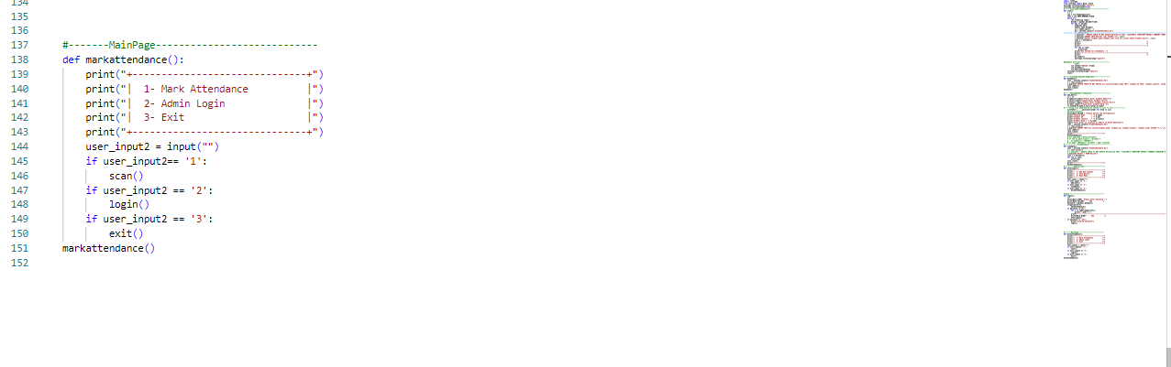
Screenshot of Admin screen

Slide 17
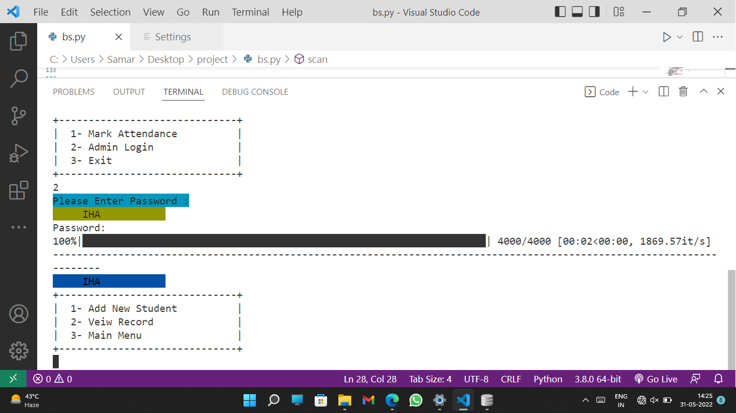
Screenshot of code flow

Slide 18
Conclusion
A simple, easy, optimized, smooth running software which enables a fully functional attendance system to manage attendance of a class, campus, society, community Hassle-free.

Slide 19
References
Researchers Explore Machine Learning Calibration
By Pure AI Editors | March 2021 - https://pureai.com/articles/2021/03/03/ml-calibration.aspx
Research on existing project
Colcify - https://clockify.me/attendance-tracker
Google workspace - https://workspace.google.com/marketplace
Camu - https://camudigitalcampus.com/cloud-campus-management-software-ppc/
Object detection with TensorFlow model and OpenCV
By Gabriel Casemiro | Jul 2016 - https://towardsdatascience.com/object-detection-with-tensorflow-model-and-opencv-d839f3e42849

Slide 20
Thank You

